Slide 1
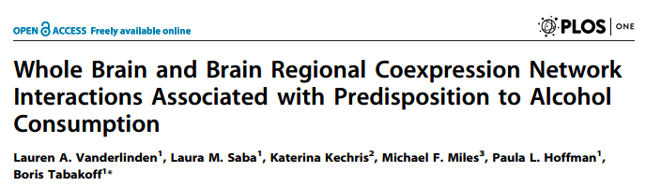
WGCNA a Network Application: Whole Brain & Brain Regional Co-expression Network Interactions
Lauren Vanderlinden, MS
Network Working Group
Feb 12, 2016

Slide 2
Biological Question & Data
Goal: To identify biological underpinnings for alcohol preference for the development of novel therapeutics and further implementation of precision medicine
Alcoholism is a complex trait
Estimated to have a heritability between 50-60%*
Yet no one has found the “alcoholism gene”
Animal Model: BXD RI panel (30 animals)
Behavioral Data: Alcohol Consumption (2-bottle choice) from 2 different labs
Parental strains have extreme alcohol consumption phenotypes
DNA Data: SNP marker set (Wellcome Trust)
≈ 1,000 markers
RNA Expression Data: Affymetrix 3’ array (Mouse 430v2) on whole brain from naïve mice
≈ 30,000 probe sets
* http://snpedia.com/index.php/Heritability

Slide 3
Weighted Gene Co-expression Network Analysis
Used WGCNA on the RNA microarray data
Popular method, well documented and very easy to use in R
Optimized for microarrays
This was my first time working in R!
Original Paper:
Bin Zhang and Steve Horvath (2005) "A General Framework for Weighted Gene Co-Expression Network Analysis", Statistical Applications in Genetics and Molecular Biology: Vol. 4: No. 1, Article 17 PMID: 16646834
http://dibernardo.tigem.it/files/papers/2008/zhangbin-statappsgeneticsmolbio.pdf
WGCNA links:
https://labs.genetics.ucla.edu/horvath/CoexpressionNetwork/Rpackages/WGCNA/Tutorials/
https://labs.genetics.ucla.edu/horvath/CoexpressionNetwork/OverviewWGCNA.pdf

Slide 4
WGCNA: More than Correlation
Simple correlation does not give connectivity
How are we measuring co-expression?
Scale-Free Network
Most biological networks have been defined as scale-free
System is robust to failure at any 1 gene
How do we get a robust measurement of connectivity to define modules?
Topological Overlap Measure
Includes a measure of how many “friends” two genes have in common
Protects against spurious correlations among genes

Slide 5
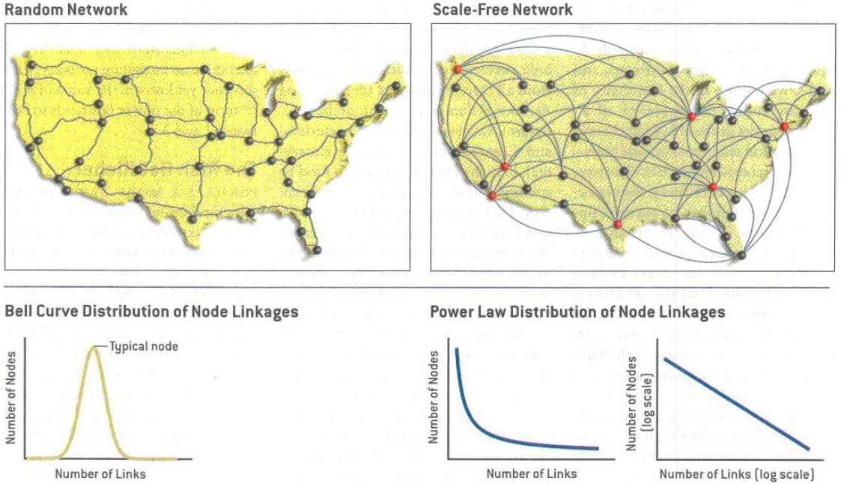
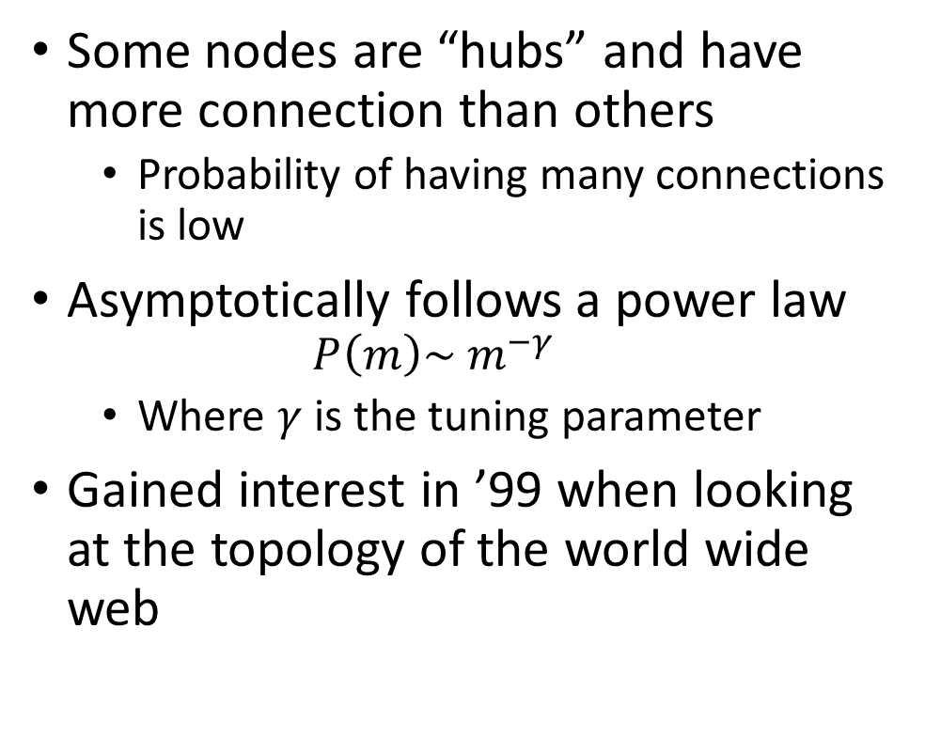
Scale-Free Networks
Some nodes are “hubs” and have more connection than others
Probability of having many connections is low
Asymptotically follows a power law
$$P\left(m\right)\sim m^{−γ}$$
Where $γ$ is the tuning parameter
Gained interest in ’99 when looking at the topology of the world wide web
Barabási, AL. Bonabeau, E. 2003. Scale-Free Networks. Scientific American 288 (5): 50–9.

Slide 6
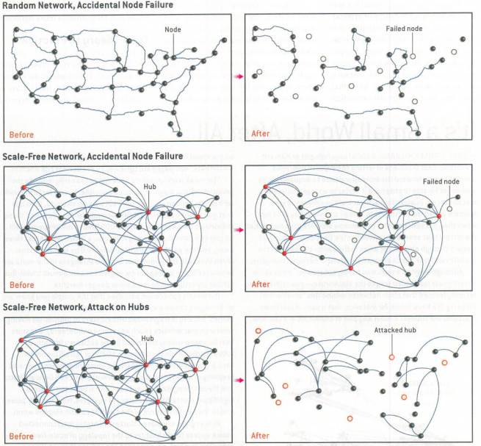
Barabási, AL. Bonabeau, E. 2003. Scale-Free Networks. Scientific American 288 (5): 50–9.

Slide 7
Analysis Flow Chart
Step 1: Correlation Matrix
Step 2: Adjacency Matrix
Step 3: Topological Overlap Matrix
Step 4:
Tree Cutting
Step 5: Summarize & Characterize Modules

Slide 8
Analysis Flow Chart
Step 1: Correlation Matrix
Step 2:
Adjacency Matrix

Slide 9

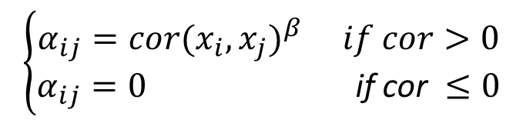
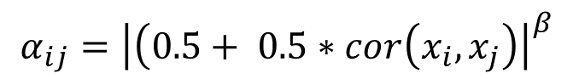
Constructing an Adjacency Matrix
Correlate your genes
corType options in package: “pearson” (default), “bicor” (non-parametric option)
Biweight midcorrelation (bicor) is median based (rather than mean based)
Determine your network type
networkType options in package: “unsigned” (default), “signed”, or “signed hybrid”
Signed networks allows you to create module with only positively associated genes
Choose a soft-thresholding power (β)
Choose a beta so you have a scale-free network
adjacency()
$$α_{ij}={\left|cor(x_{i}, x_{j})\right|}^{β}$$
Unsigned Network
$$α_{ij}={\left|\left(0.5+ 0.5∗cor\left(x_{i}, x_{j}\right)\right.\right|}^{β}$$
Signed Network
$$\left\{\begin{aligned}α_{ij}=cor{(x_{i}, x_{j})}^{β} if cor>0 \\ α_{ij}=0 \text{if} \text{cor} ≤0\end{aligned}\right.$$
Signed Hybrid Network

Slide 10
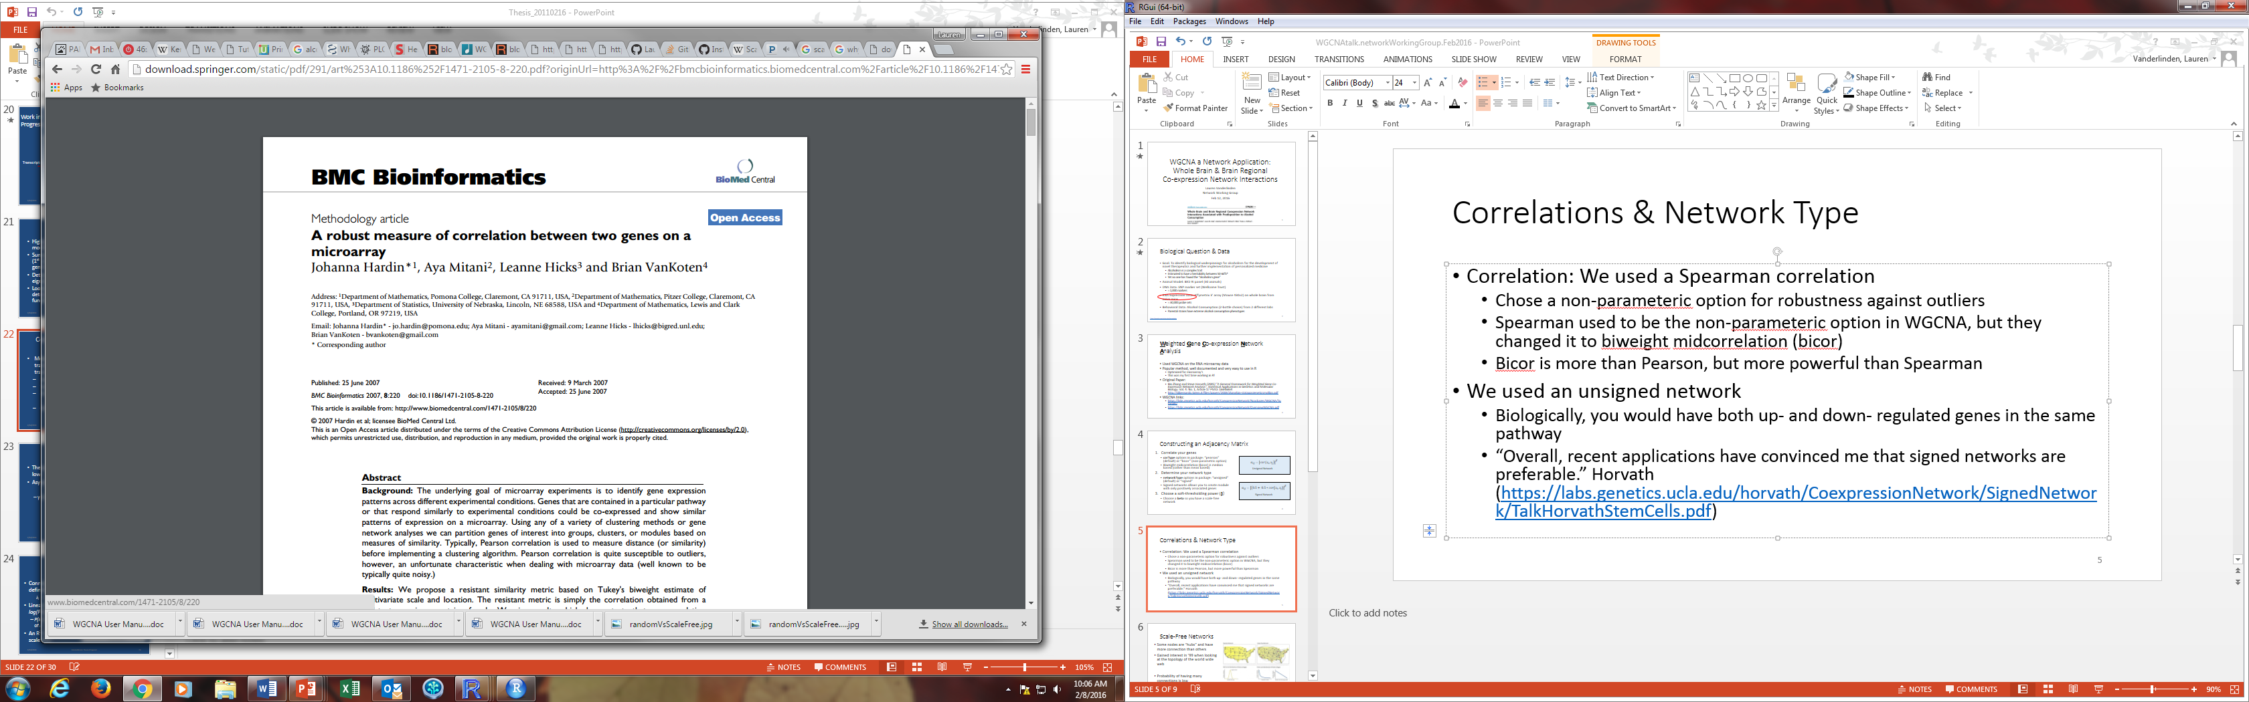
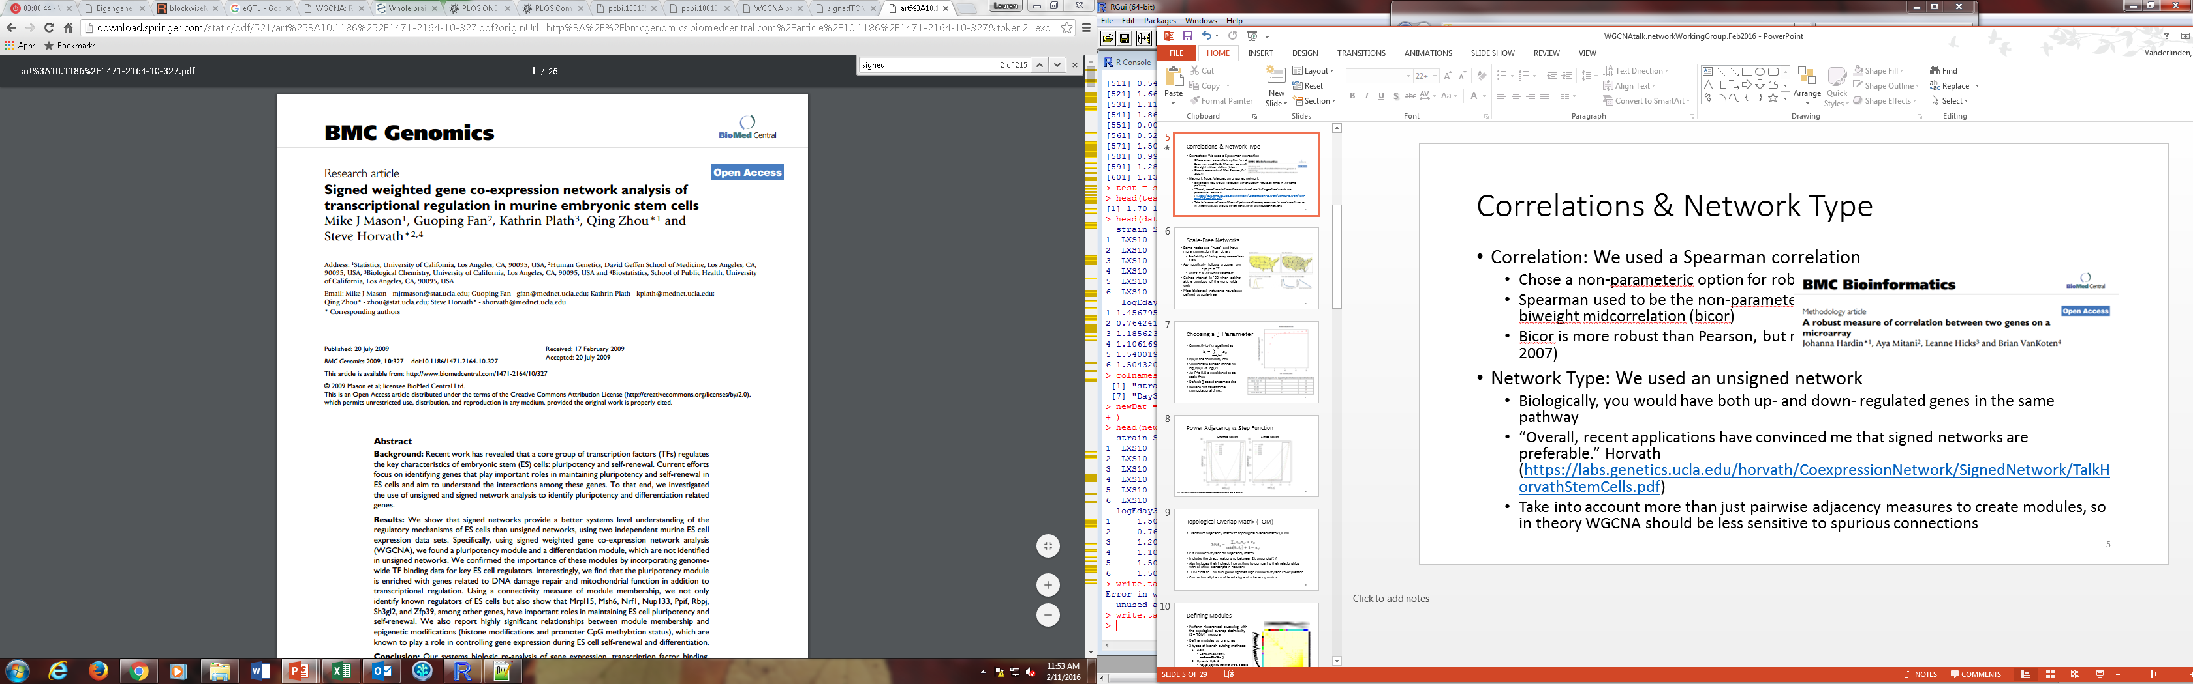
Correlations & Network Type
Correlation: We used a Spearman correlation
Chose a non-parameteric option for robustness against outliers
Spearman used to be the non-parameteric option in WGCNA, but they changed it to biweight midcorrelation (bicor)
Bicor is more robust than Pearson, but more powerful than Spearman (Hardin et al, 2007)
Network Type: We used an unsigned network
Biologically, you would have both up- and down- regulated genes in the same pathway
“Overall, recent applications have convinced me that signed networks are preferable.” Horvath (https://labs.genetics.ucla.edu/horvath/CoexpressionNetwork/SignedNetwork/TalkHorvathStemCells.pdf)
Take into account more than just pairwise adjacency measures to create modules, so in theory WGCNA should be less sensitive to spurious connections

Slide 11
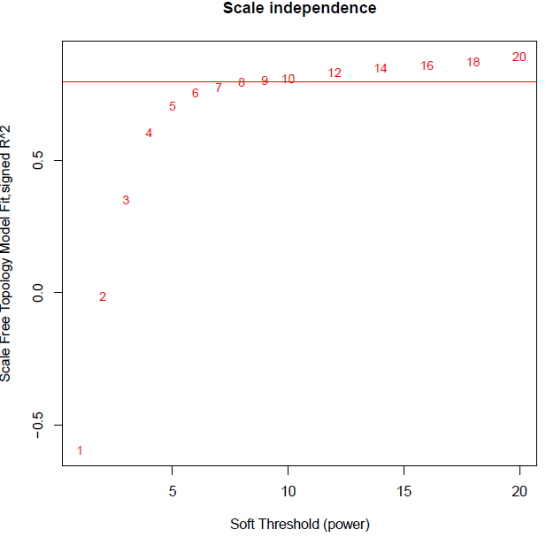
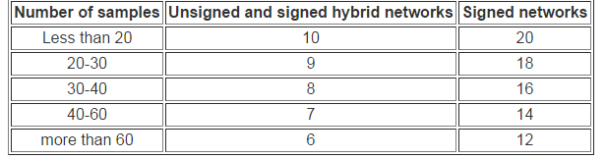
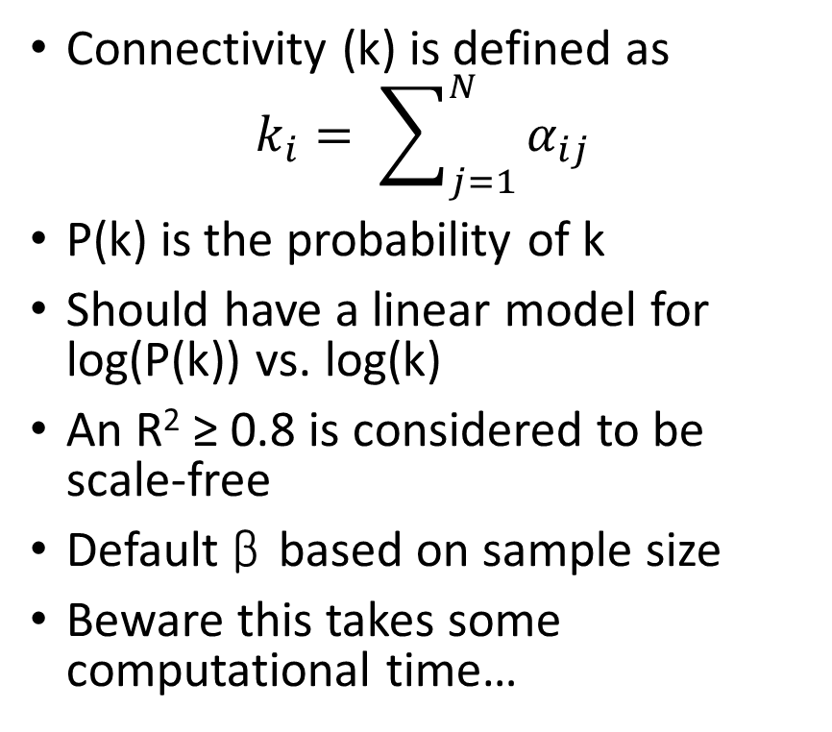
Choosing a β Parameter
Connectivity (k) is defined as
$$k_{i}= \sum_{j=1}^{N}{α_{ij}}$$
P(k) is the probability of k
Should have a linear model for log(P(k)) vs. log(k)
An R² ≥ 0.8 is considered to be scale-free
Default β based on sample size
Beware this takes some computational time…
Notes:
Absolute minimum is 15 samples, but they don’t recommend less than 20.

Slide 12
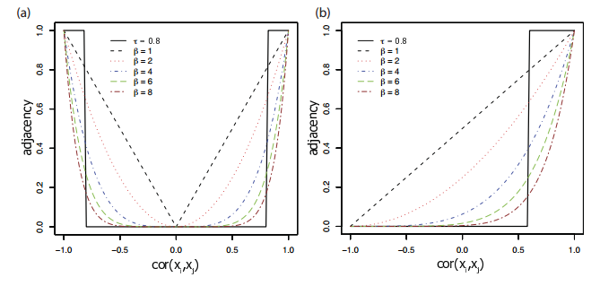
Power Adjacency vs Step Function
Unsigned Network Signed Network
https://labs.genetics.ucla.edu/horvath/CoexpressionNetwork/WORKSHOP/2012/Talk1OverviewWGCNAHorvath.pdf

Slide 13
Analysis Flow Chart
Step 1: Correlation Matrix
Step 2: Adjacency Matrix
Step 3: Topological Overlap Matrix
Step 4:
Tree Cutting
Step 5: Summarize & Characterize Modules

Slide 14
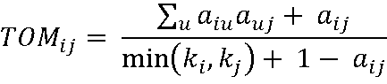
Topological Overlap Matrix (TOM)
Transform adjacency matrix to topological overlap matrix (TOM)
k is connectivity and a is adjacency matrix
Includes the direct relationship between 2 transcripts (i, j)
Also includes their indirect interactions by comparing their relationships with all other transcripts in network
TOM close to 1 for two genes signifies high connectivity and co-expression
Can technically be considered a type of adjacency matrix
TOMsimilarity()

Slide 15
Analysis Flow Chart
Step 1: Correlation Matrix
Step 2: Adjacency Matrix
Step 3: Topological Overlap Matrix
Step 4:
Tree Cutting
Step 5: Summarize & Characterize Modules

Slide 16
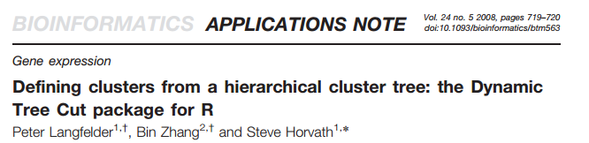
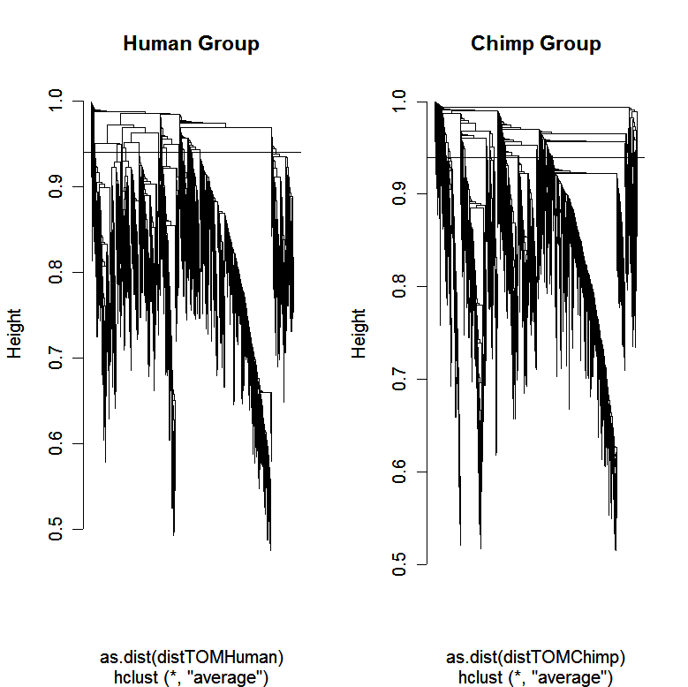
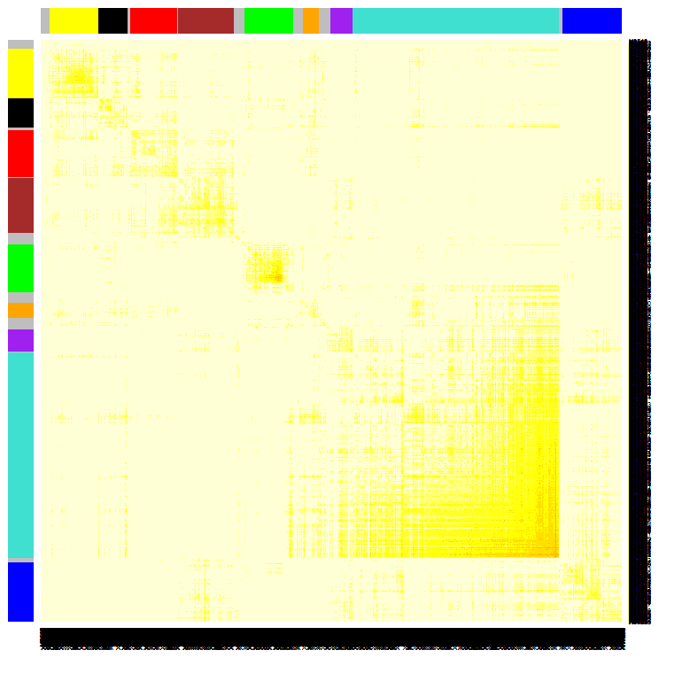
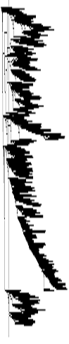
Defining Modules
Perform hierarchical clustering with the topological overlap dissimilarity (1 – TOM) measure
Define modules as branches
2 types of branch cutting methods:
Static
Constant cut height
cutreeStatic()
Dynamic Hybrid
Not all defined branches are at a specific cut height
Combines static and partition around medoids (PAM)clustering
cutreeDynamic()
https://labs.genetics.ucla.edu/horvath/CoexpressionNetwork/WORKSHOP/2012/Talk1OverviewWGCNAHorvath.pdf

Slide 17
Tree Cutting Example
https://labs.genetics.ucla.edu/horvath/CoexpressionNetwork/WORKSHOP/2012/Talk1OverviewWGCNAHorvath.pdf

Slide 18
Tree Cutting Example
https://labs.genetics.ucla.edu/horvath/CoexpressionNetwork/WORKSHOP/2012/Talk1OverviewWGCNAHorvath.pdf

Slide 19
Tree Cutting Example
https://labs.genetics.ucla.edu/horvath/CoexpressionNetwork/WORKSHOP/2012/Talk1OverviewWGCNAHorvath.pdf

Slide 20
Tree Cutting Example
https://labs.genetics.ucla.edu/horvath/CoexpressionNetwork/WORKSHOP/2012/Talk1OverviewWGCNAHorvath.pdf

Slide 21
Tree Cutting Example
https://labs.genetics.ucla.edu/horvath/CoexpressionNetwork/WORKSHOP/2012/Talk1OverviewWGCNAHorvath.pdf

Slide 22
Settings for Defining Modules blockwiseModules()
mergeCutHeight (default = 0.15)
Static cut height to define modules
minModuleSize (default = 20)
Minimum size of a module you will accept, we used 5 alcohol related traits very complex and we are expecting smaller modules
If you are doing enrichment analysis you want a minimum of 20 genes
deepSplit (default = 2)
Integer value between 0 (least sensitive) and 4 (most sensitive) for a simplified control on how the module detection should be module splitting
We used 4 because we wanted smaller modules
pamRespectsDendro (default = TRUE)
Only use if using dynamic cut
where PAM respects the dendrogram and it won’t group objects into clusters unless they are from the same branch

Slide 23
General Results for Whole Brain Network
Number of Probesets Placed Into Modules | 28,867
Number of Modules Identified | 499
Minimum Module Size | 5
Maximum Module Size | 2,881
Median Module Size | 9
Notes:
Not surprising the # probe sets placed into modules is highest in whole brain. We filtered on DABG on whole brain and were able to apply a mask….

Slide 24
Analysis Flow Chart
Step 1: Correlation Matrix
Step 2: Adjacency Matrix
Step 3: Topological Overlap Matrix
Step 4:
Tree Cutting
Step 5:
Summarize & Characterize Modules

Slide 25
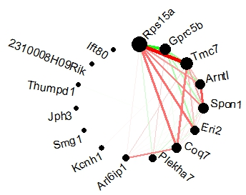
Summarizing Modules
HUB gene
Most connected gene in your module
Example: for hotpink3 hub gene is Rps15a
Eigengene
1st principal component of module
Check to see how much variance the eigengene explains
Hotpink3 module
Notes:
Rps15a = ribosomal protein S15A
The minimum % variance explained by candidate eigengene in whole brain = 91%

Slide 26
Characterization of Modules
Gene Ontology and Pathway Enrichment
Cell-type specific expression
Correlation of eigengene with physiological or behavioral trait
Source of expression control
Transcription factors
microRNA
Common eQTL
Module eigengene QTL (E-QTL)
What we did to find candidate modules:
Correlation with Phenotype
Correlated the eigengenes with alcohol consumption
Module Eigengene Quantitative Trait Loci (E-QTL)
common genetic control of expression of transcripts within module
overlap with a behavioral QTL for alcohol consumption

Slide 27
Other Useful WGCNA functions
Function | What it does
chooseTopHubInEachModule() | identifies the hub gene in each module
moduleEigengenes() | calculates the module's eigengenes
propVarExplained() | calculates the proportion of variance explained by eigengenes
exportNetworkToCytoscape() | exports a network in edge and node list files in a format suitable for importing to Cytoscape
plotNetworkHeatmap() | network heatmap plot
plotDendroAndColors() | dendrogram plot with color annotation of objects
plotMEpairs() | pairwise scatter plots of eigengenes
circlePlot()* | visualize connectivity within a module
GOenrichmentAnalysis() | calculation of GO enrichment (experimental)
networkScreening() | identifies genes related to a trait by taking into account both the network and gene-centric info (experimental)

Slide 28
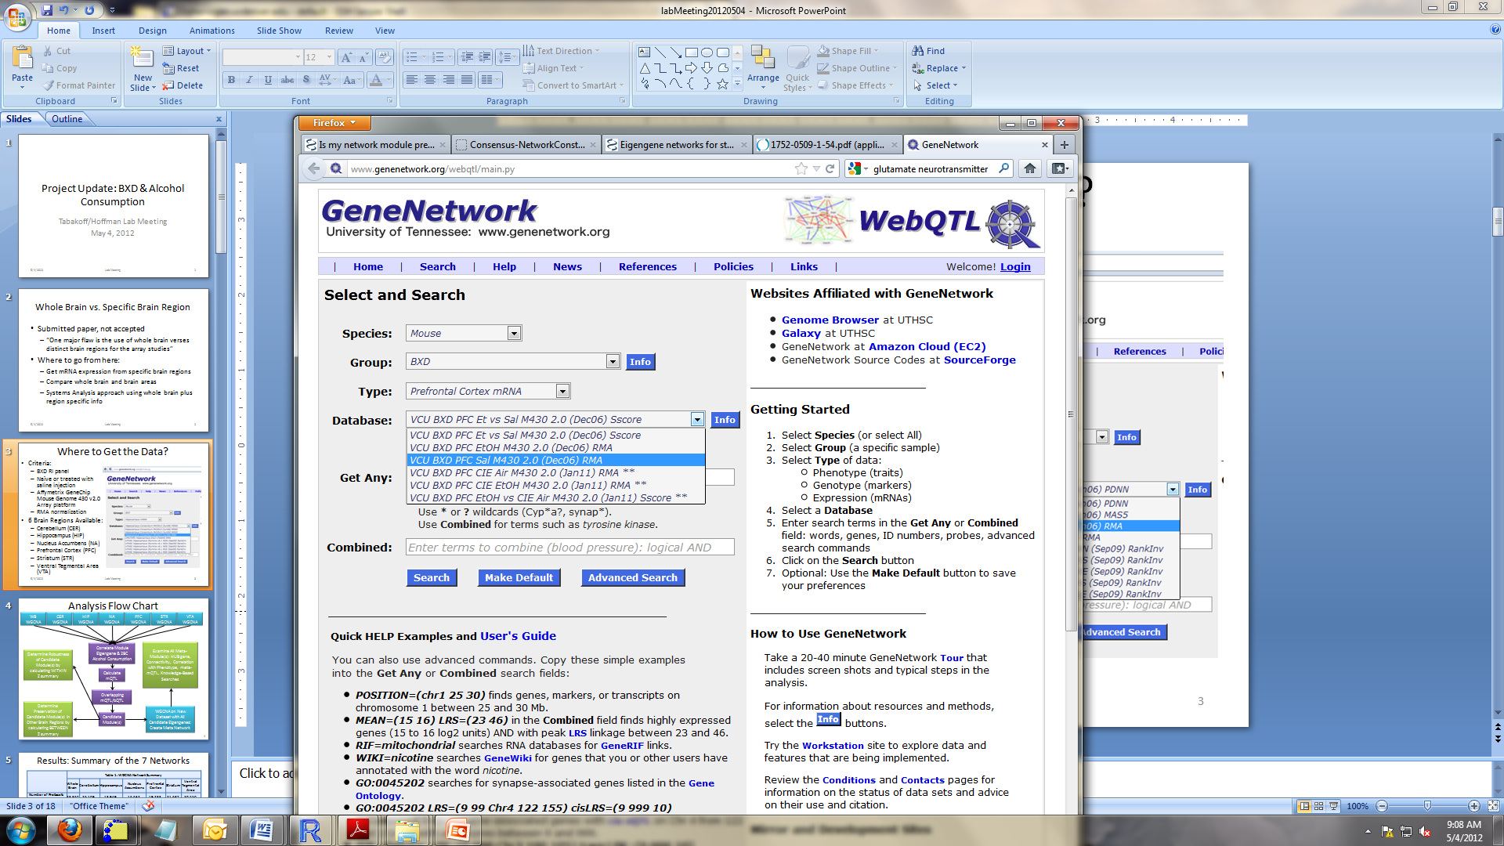
Comparing Across Brain Areas
Whole Brain vs Brain Region
Able to get publicly available 3’ array data from GeneNetwork
6 brain regions:
Cerebellum (CER)
Hippocampus (HIP)
Nucleus Accumbens (NA)
Prefrontal Cortex (PFC)
Striatum (STR)
Ventral Tegmental Area (VTA)
Created a network for each area using same probesets and same parameters as whole brain

Slide 29
Summary of the 7 Networks
 | Table 1: WGCNA Network Summary
 | Whole Brain | Cerebellum | Hippocampus | Nucleus Accumbens | Prefrontal Cortex | Striatum | Ventral Tegmental Area
Number of Probesets Placed Into Modules | 28,867 | 26,109 | 18,949 | 16,632 | 19,288 | 21,687 | 20,550
Number of Modules Identified | 499 | 604 | 337 | 512 | 595 | 300 | 433
Minimum Module Size | 5 | 5 | 5 | 5 | 5 | 5 | 5
Maximum Module Size | 2,881 | 4,270 | 3,185 | 2,928 | 2,144 | 3,903 | 3,440
Median Module Size | 9 | 8 | 8 | 9 | 8 | 9 | 9
Number of Modules Correlated with Alcohol Consumption at Fisher’s unadjusted p-value < 0.01 | 12 | 2 | 5 | 19 | 7 | 9 | 12
Modules Significantly Correlated with Alcohol Consumption and have mQTL/bQTL overlap (Candidate Modules) | 4 | 1 | 1 | 13 | 5 | 4 | 5
Minimum Proportion of Variance in Candidate Module(s) Captured by Eigengene | 91% | 98% | 99% | 88% | 82% | 96% | 83%
Notes:
Not surprising the # probe sets placed into modules is highest in whole brain. We filtered on DABG on whole brain and were able to apply a mask….

Slide 30
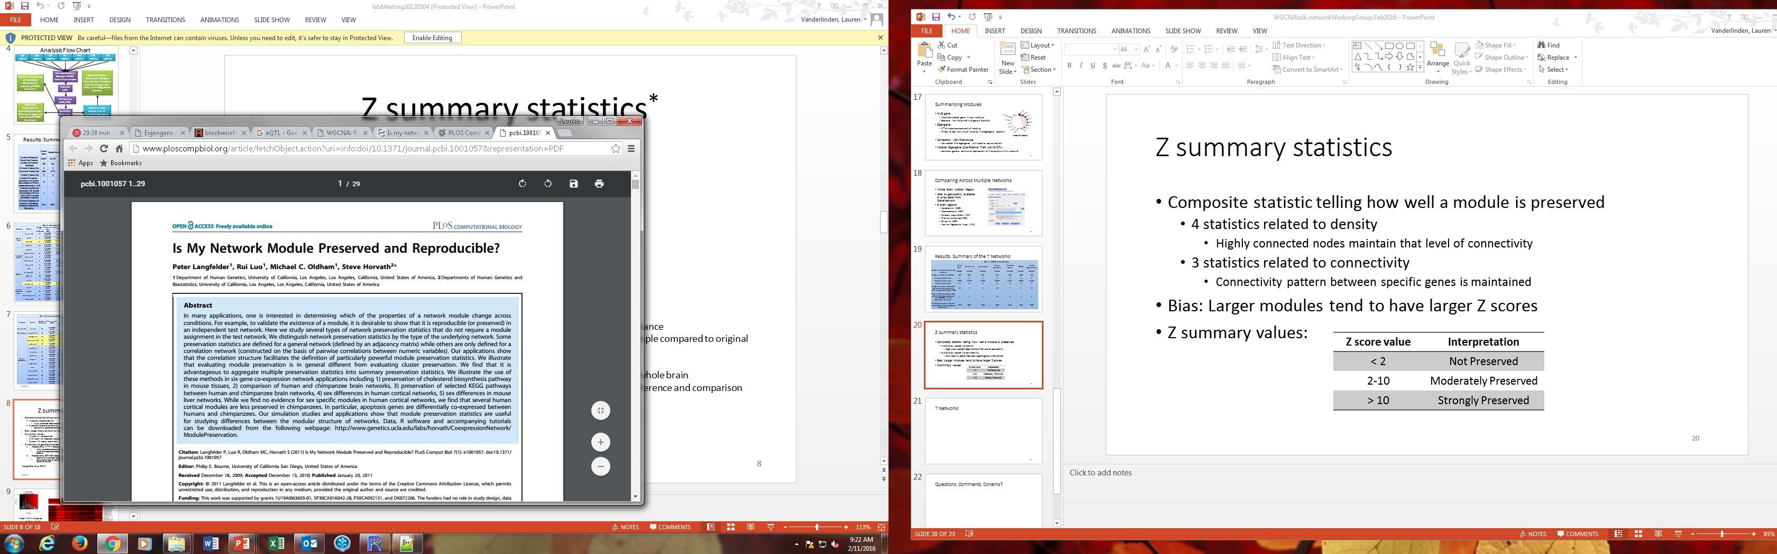
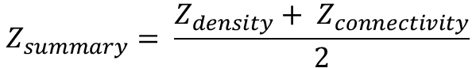
Z summary statistics
Composite statistic telling how well a module is preserved
4 statistics related to density
Highly connected nodes maintain that level of connectivity
3 statistics related to connectivity
Connectivity pattern between specific genes is maintained
Bias: Larger modules tend to have larger Z summary scores
modulePreservation()
$$Z_{density}=median(Z_{meanCor}, Z_{meanAdj}, Z_{propVarExpl}, Z_{meanKME})$$
$$Z_{connectivity}=median(Z_{cor.kIM}, Z_{cor.kME}, Z_{cor.cor})$$
$$Z_{summary}= \frac{Z_{density}+ Z_{connectivity}}{2}$$
Z summary | Interpretation
< 2 | Not Preserved
2-10 | Moderately Preserved
> 10 | Strongly Preserved

Slide 31
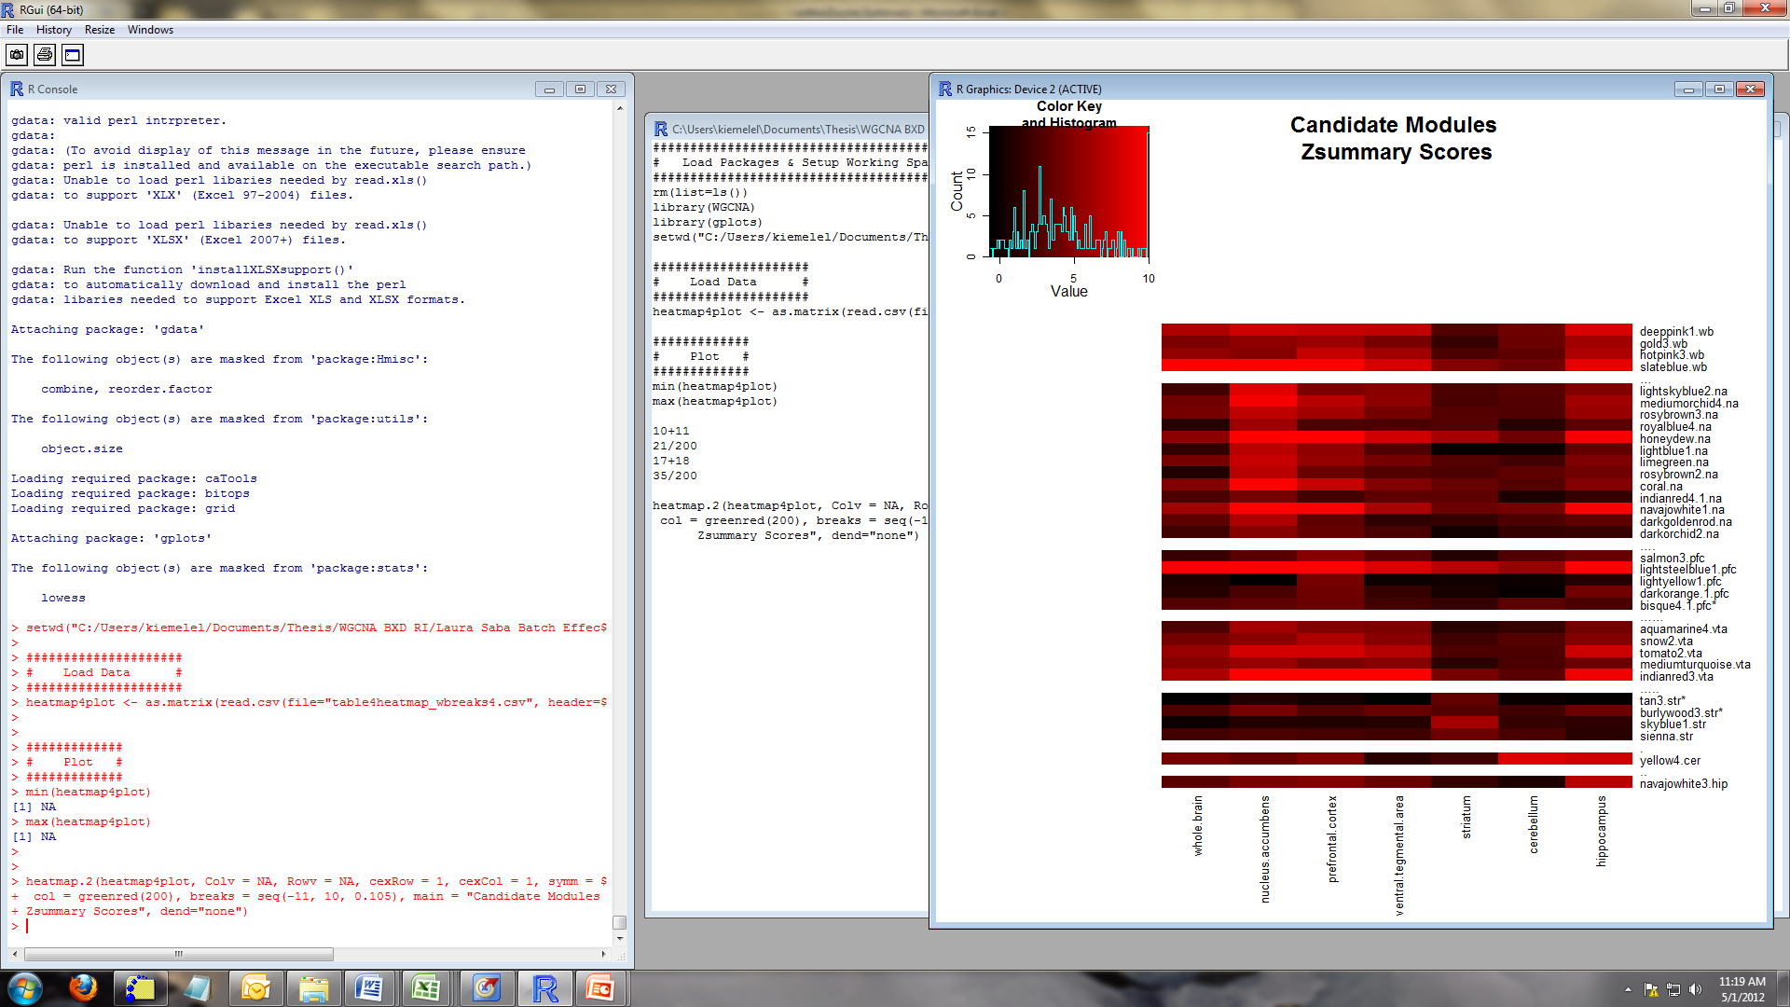
Methods to Generate Z summary Scores
Reproducibility WITHIN dataset
Verify candidate modules were of high quality and not generated by chance
Used 100 bootstrap samples, calculated Z summary for each bootstrap sample compared to original dataset
Reproducibility BETWEEN datasets
Determine if candidate modules are preserved in other brain regions/whole brain
Calculated Z summary by setting the dataset module originated from as reference and comparison region as test set
Note: you need to have same gene identifiers!
Mean Within Z scores range: 3.05 to 16.15
Only 3 modules have lower 95% CI bound < 2 (noted with *)
Between Z scores range: -0.67 to 17.05

Slide 32
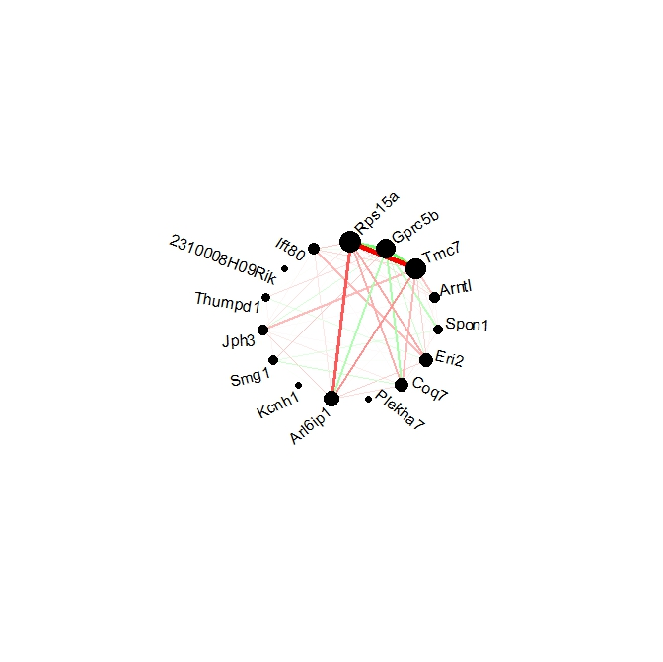
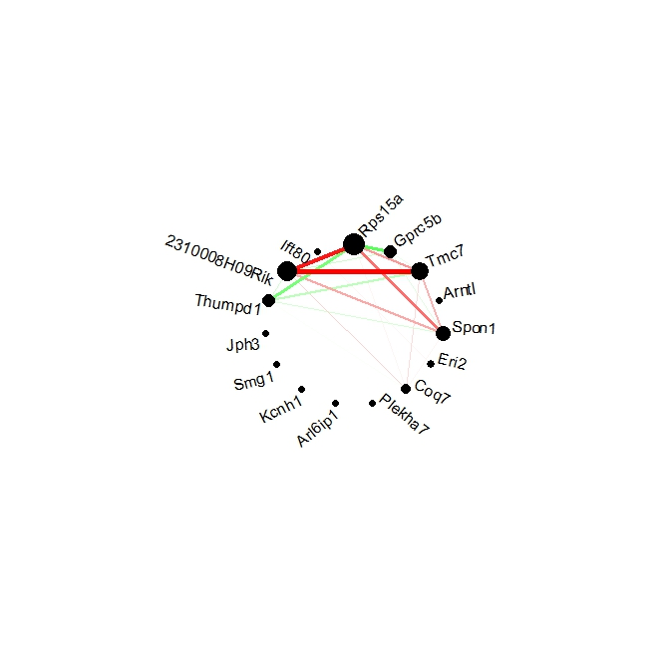
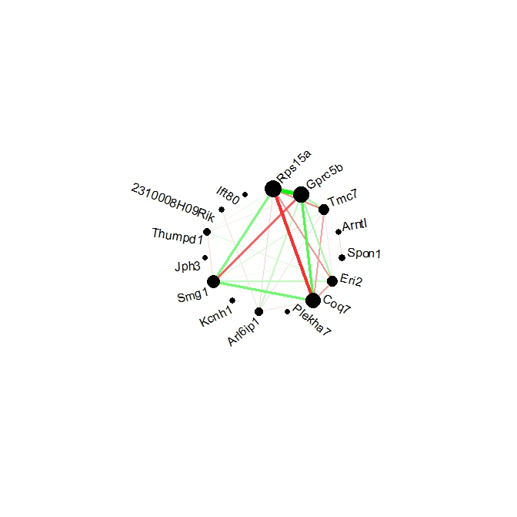
Hotpink3 from Whole Brain
Prefrontal Cortex
Striatum
Ventral Tegmental Area
Whole Brain

Slide 33
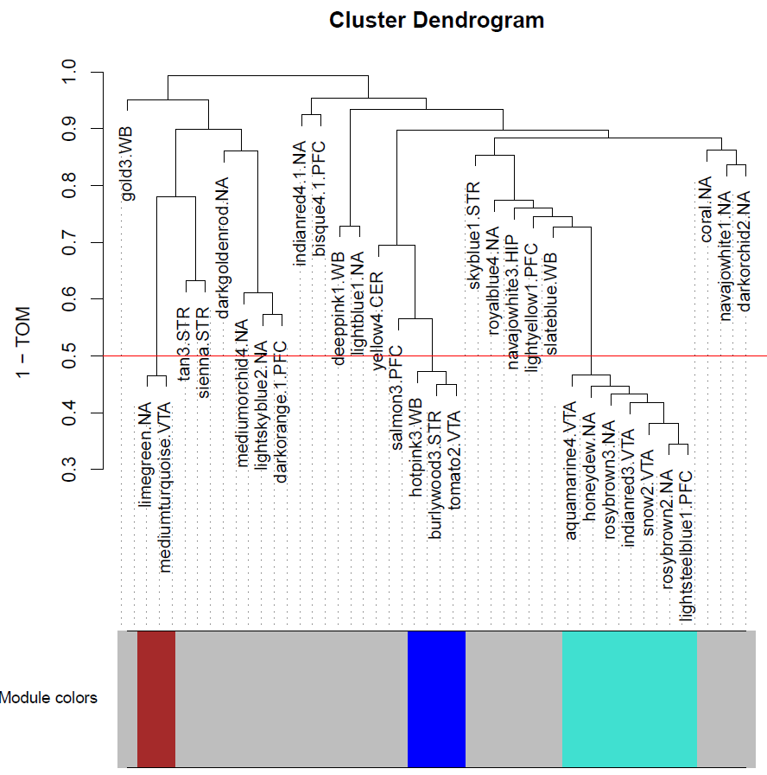
Eigengene Network
Notes:
Call these meta-modules

Slide 34
Modules Can Be Useful To…
Add biological context to unannotated or under annotated genes
Especially useful in organisms with little annotation (e.g. rats)
Explaining biomarkers
Make sense of biomarker given the other genes within module
How do module structure changes in different environments
Treatment
Tissue
Finding target genes for pharmaceutical therapies

Slide 35
Biological Conclusions…
“Transcripts code for proteins that are associated with protein processing – synthesis (through tRNA and mRNA metabolism), folding (chaperone proteins) and trafficking and degradation (ubiquitination, endosomal/lysosomal trafficking). The localization of the products of many of the correlated transcripts is the ER and Golgi apparatus, where the synthesis and maturation of extracellular membrane proteins occur.”
“Based on these findings, one may postulate that pre-alcohol consumption differences in the activity of protein processing pathways associated with the ER and Golgi machinery in particular brain regions contributes to the “sensation” that an individual experiences when alcohol is consumed, thereby influencing the amount of alcohol consumption.”

Slide 36
Pro and Con list for WGCNA
PRO’s:
Easy to use and understand
Peter Langfelder normally answers all questions in online forums directly.
Robust network
Scale-free
Indirect & Direct Interactions
Accepted by community
CON’s:
Missing non-linear relationships
How do we choose which genes to include in the module?
I find the tree cutting the most difficult evaluate
Are these modules truly clustered together functionally?

Slide 37
Something to Consider: Colocalization or Functional Results
Some modules have genes physically in close proximity to one another and have extremely strong cis-QTL’s
Partial correlation adjusting for allele in the cis-QTL
Our candidate modules stayed highly correlated
Confounding issue: many genes functionally related are also physically located near each other

Slide 38
Thanks!
My advisor: Laura Saba
Committee members: Katerina Kechris and Anna Baron
All the people in the Saba, Tabakoff and Hoffman Lab’s
Colorado Biostatistics Consortium (CBC)
My example code & this presentation are available through GitHub:
https://github.com/Vanderll/WGCNA
More complete set of example code at:
https://github.com/TabakoffLab/WGCNA/tree/master/programs/orig

Slide 39
Extra Slides

Slide 40
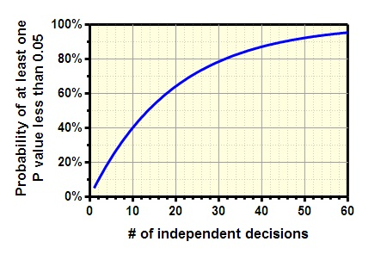
Gene-Centric vs Network Analyses
A gene-centric approach is the traditional way to analyze data
Not appropriate given our phenotype
Genes and their products may interaction at many different levels
Doesn’t take these epistatic effects into account and is biologically oversimplified
Multiple testing correction methods assumes all tests are independent from one another
Network Analyses
Focuses on modules/gene systems (i.e. group of co-expressed transcripts)
Gain power
Gene Centric |  | Network
# True Differential Expression | Power | # True Differential Expression | Power
20 | 0.650 | 1 | 0.740
30 | 0.684 | 2 | 0.792
40 | 0.708 | 3 | 0.821
50 | 0.726 | 4 | 0.840
60 | 0.740 | 5 | 0.854
Notes:
Power table:
Assuming 30,000 test for gene centric and 500 tests for network
K represents the true amount of genes that correlate with phenotype
Alpha adj is the adjusted alpha level using FDR
Sample size = 30
Nominal alpha = 0.05

Slide 41
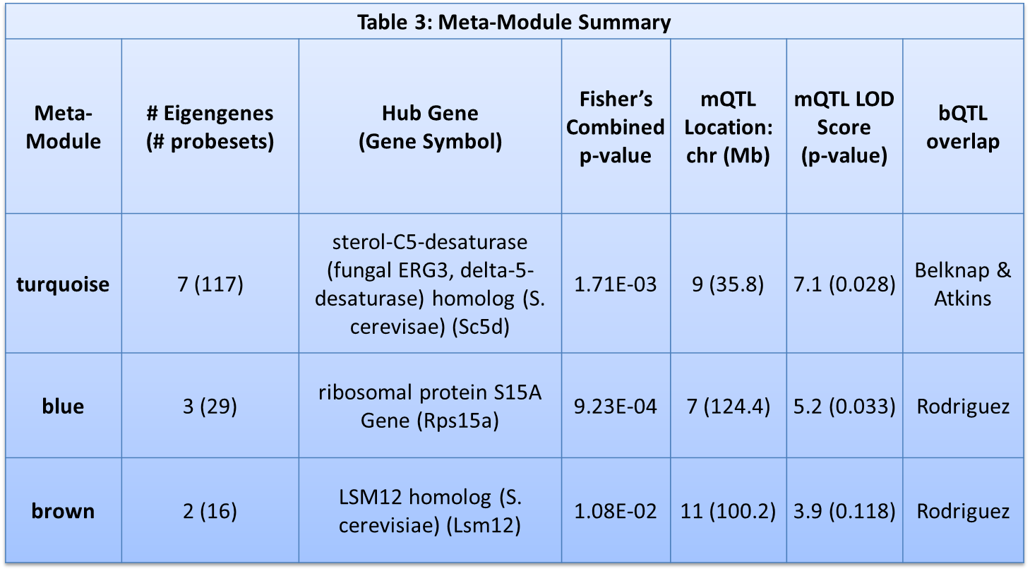
Meta Module Summary

Slide 42
Combined Candidate Module
Identified in both gene level and isoform level expression data
Identified in either gene level orisoform level expression data
Negative correlation
Positive correlation
Saba et al (2015). The sequenced rat brain transcriptome, its use in identifying networks predisposing alcohol consumption. FEBS J. 2015 Sep;282(18):3556-78.
Notes:
Citation

Slide 43
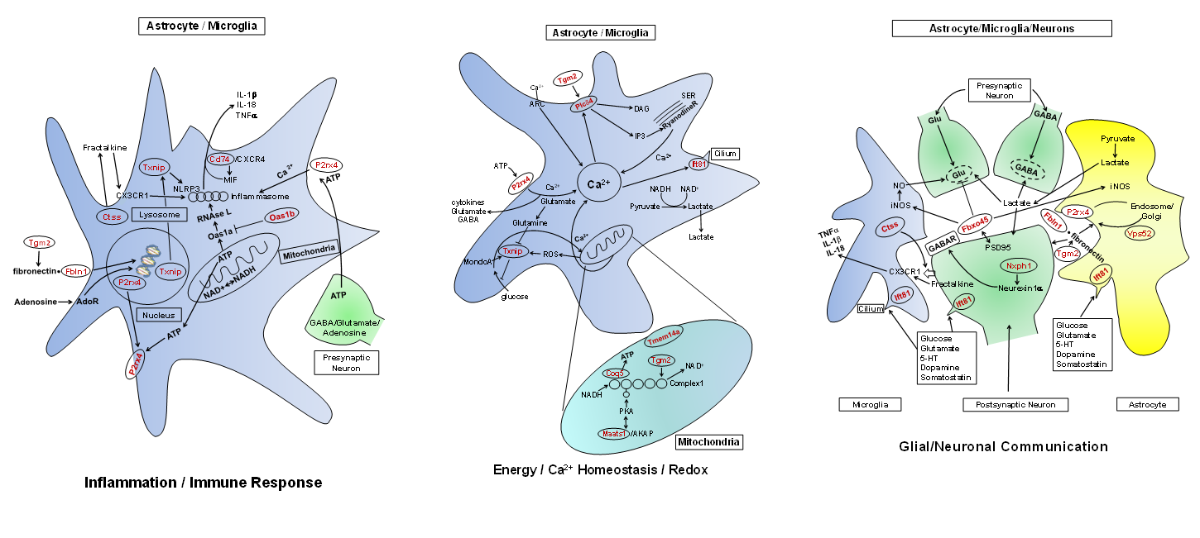
Biological Context from Pathway
Energy/Ca2+ Homeostasis/Redox
Inflammation/Immune Response
Glial/Neuronal Communication
Saba et al (2015). The sequenced rat brain transcriptome, its use in identifying networks predisposing alcohol consumption. FEBS J. 2015 Sep;282(18):3556-78.

Slide 44
Testing the Hypothesis Non-Coding Follow-up
p = 0.038
RNA expression of GENE_07346 (hub gene for associated module) was negatively associated with drinking

